Slide 1
TalentMagnet
D.T1.1.5 Slide deck on the main findings of the Baseline Study

Slide 2
1
2
3
4
5
INTRODUCTION
THE CHALLANGE
TALENTMAGNET SURVEYS
STATE OF THE ART
TALENTMAGNET SOLUTION
1.1 The TalentMagnet project
1.2 Purpose
1.3 Key terms
3.1 Survey among target groups
3.2 Partner-level situation analysis
3.3 Young talents survey
3.4 Private sector survey
4.1 Competitiveness of cities
4.2 Good practices
4.3 Capitalization
5.1 TalentMagnet approach
5.2 TalentMagnet toolkit
5.3 Conclusion

Slide 3
INTRODUCTION

Slide 4
The TalentMagnet project
Improved Institutional Capacities and New Multilevel Governance for
Talent Attraction and Retention in the Danube Region
01/07/2020 – 30/06/2022
29 partners
12 countries
2.5 M EUR
Target groups
Local/regional policy-planners, decision-makers; urban and regional administrations; stakeholders and partners from the quadruple helix; community members and the public

Slide 5
Bring everyone to the same level of initial knowledge
Share considerations of the potential role of local and regional policies
Purpose
Identify the current state of affairs
Create a common understanding
Provide overview of planned TalentMagnet interventions
Serve as a starting point for the development of talent attraction and retention plans and strategies

Slide 6
Key terms
Talent Management is one of the most important instruments in HR management. In relation to our document Talent Management is a set of tools and actions to attract, develop and retain highly educated talented people. It´s performed on city, regional or national level.
Talent management
Talent
Talent is a set of abilities of a person including skills, knowledge and capacity for growth and development. And refers to people with innate gifts as well as people who have learned knowledge and skills related to a particular field.
Talent attraction and retention
Talent Attraction and Retention is a part of Talent Management and consists of actions, programs and processes to actively attract, welcome or keep talented people. It can be performed on company, city, regional or national level.

Slide 7
THE CHALLANGE

Slide 8
Youth migration and brain drain is intensifying in the Danube Region.
Today’s youths are growing up with greater possibilities to work or study abroad and are using these chances to a high extent.
It means a dominant threat for Danube countries to lose young, highly-skilled individuals (although to different extent in more and less developed areas).
It has an impact on local, national and regional levels. Socio-economic consequences include loss of financial capital, innovation and productivity, loss of know-how, of experts and of potential political activists and opinions, thus it is an obstacle for development.
Tailor-made responses are needed with local policies that may vary considerably from one country to another.

Slide 9
TALENTMAGNET SURVEYS

Slide 10
Survey among target groups
Partner-level situation analysis
Analysed the statistical data and publicly available information in partner cities, covering four key areas (demography and society; economy and labor market; education; quality of life indicators).
Identified the current strengths and weaknesses in the cities, regions, and countries in four key areas (education, labor market, housing market and quality of life) important for the TalentMagnet project, and crucial for attracting and retaining talents.
It collected the opinion of the private sector with a questionnaire including company/business-specific questions (e.g. approach to challenges) and talent-specific questions (e.g. strategies in recruitment and talent attraction).
It collected information about the living conditions of hometown and the place of destination, potential migration reasons and aspirations of young talents.
Its aim was to compare the living conditions and identify push and pull factors.
Young talents survey
Private sector survey

Slide 11
SPECIFIC NEEDS
YOUNG TALENTS | PRIVATE SECTOR
Quality job opportunities Prospering business environment Attractive corporate culture enabling flexibility and work-life balance Personal and career development opportunities Innovative formal and non-formal education Affordable and more diverse housing options | More qualified / highly skilled young talents More home office / remote / international employees Higher mobility and greater diversity Development of innovative approaches to young talent acquisition, including employer branding strategies Increase of business effectiveness to meet the pay demands

Slide 12
STATE OF THE ART

Slide 13
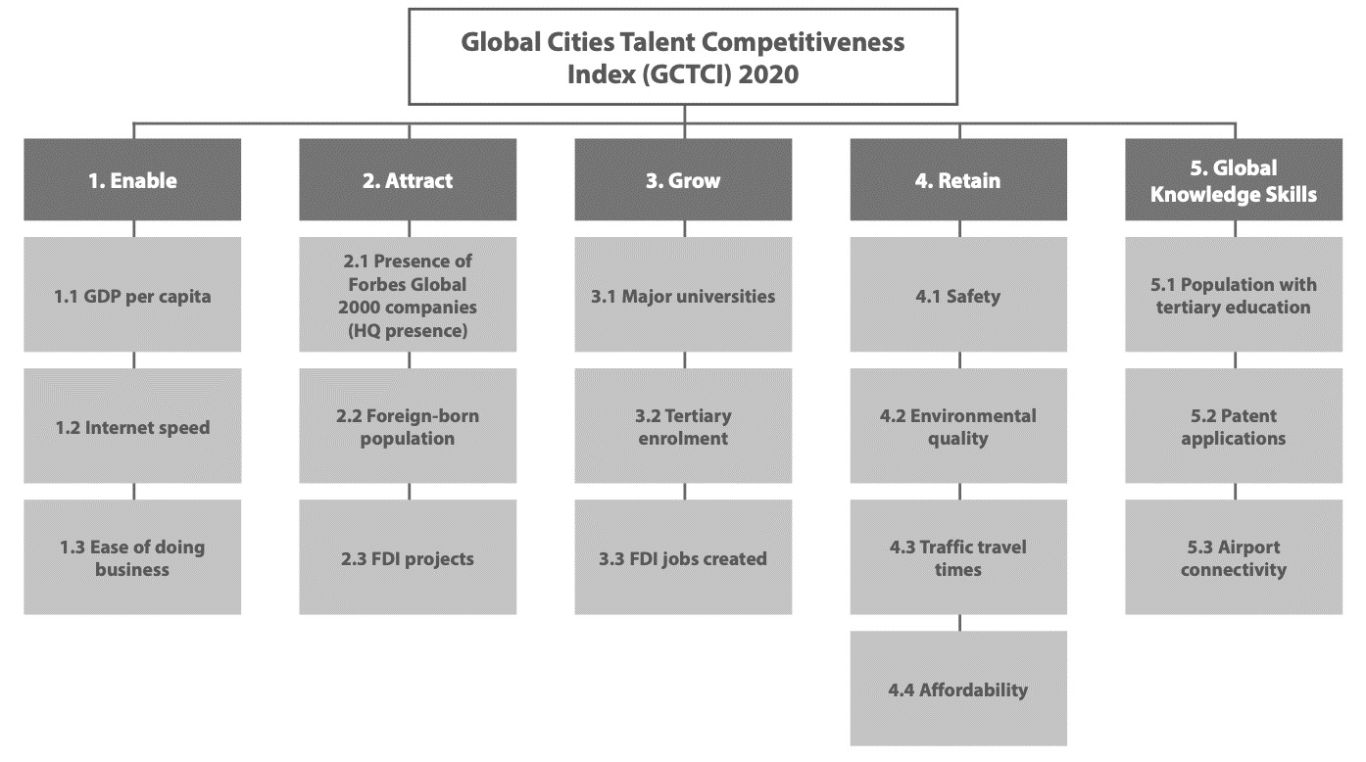
Source: The Global Talent Competitiveness Index (GTCI) 2020 Report

Slide 14
Good practices and capitalization
Numerous good practices on the field of talent attraction and retention are detailed in the TalentMagnet Good Practice Catalogue.
Some examples:
90 Day Finn project in Helsinki, Finland
Bizkaia Talent in Basque Country, Spain
Center for Applied Technology (ZAT) in Leoben, Austria
BulgariaWantsYou in Sofia, Bulgaria
A lot can be learn from similar EU-funded projects, such as:
YOUMIG
EDU-LAB
ATTRACTIVE DANUBE
WORKING4TALENT
CartTalent
TALENTAS
Gen-Y City

Slide 15
TALENTMAGNET SOLUTION
5

Slide 16
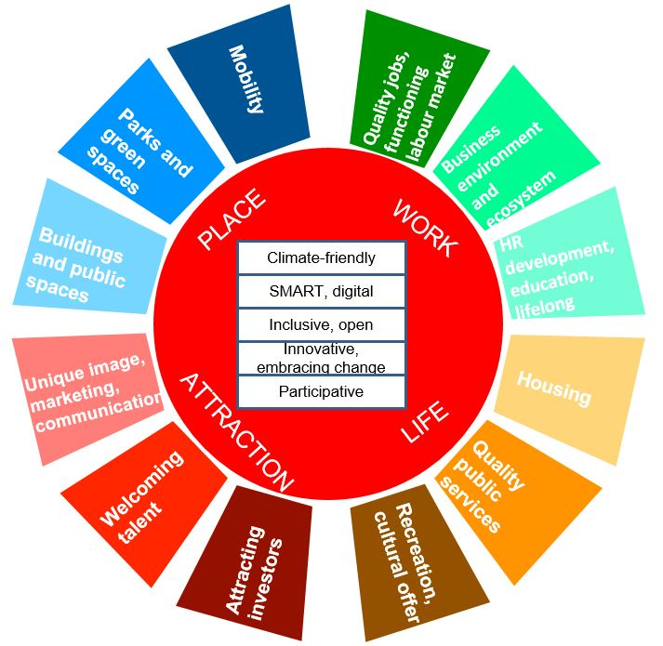
The TalentMagnet holistic approach
integrated view of diverse factors
built on multilevel governance
aim: to shape talent-competitive cities and regions

Slide 17
TalentMagnet toolkit
 | Activity 1
 | Toolkit development
 | Local talent clubs established
 | TalentMagnet App
 | Urban hackatons implemented
 | Quadruple Helix in action for a New Multilevel Governance Model
 | TalentMagnet Guidebook
 | Activity 2
 | Preparing partners for establishing and running the improved Multilevel Governance Model
 | Interactive training materials
 | Pool of Certified TalentMagnet Experts
 | Training on New Multilevel Governance Model on Talent Attraction and Retention
 | Activity 3
 | Preparing local QH actors to cooperate in talent attraction and retention
 | E-learning materials
 | Local learning materials in national languages
 | Interactive local training courses

Slide 18
Conclusion
As there is no one-size-fits-all solution, each city and municipality would have to assess its own specific priorities, as well as the expectations of local youth to build and implement a tailored talent attraction and retention strategy.
Facilitating co-operations, developing and applying a New Multilevel Governance Model is a possible way to address the challenges.
To ensure the sustainability of talent attraction and retention policies it is crucial to have supportive framework conditions (legislation, funding, support organizations) in place on local, national, and – to some extent – transnational level.

Slide 19
Thank you for your attention!
https://www.facebook.com/TalentMagnetProject
http://www.interreg-danube.eu/approved-projects/talentmagnet

