Slide 1
BMS system in production company
dr inż. Paweł Buchwald

Slide 2
Benefits of using BMS
Aggregating information about company operations
Tracking the implementation of industrial processes and the utilization of hardware resources
Faster detection of critical incidents
Proactive management of the IT department

Slide 3
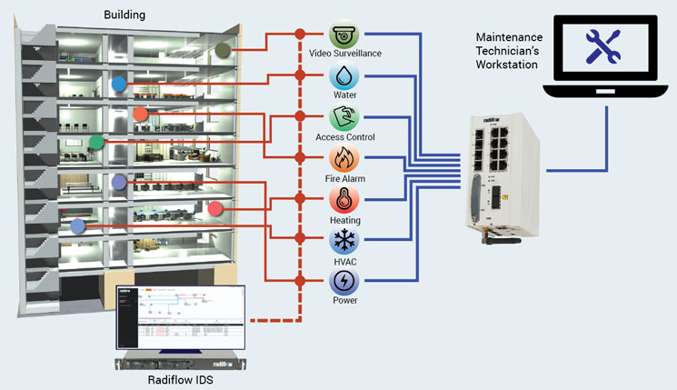
Simple architectuer of BMS system

Slide 4
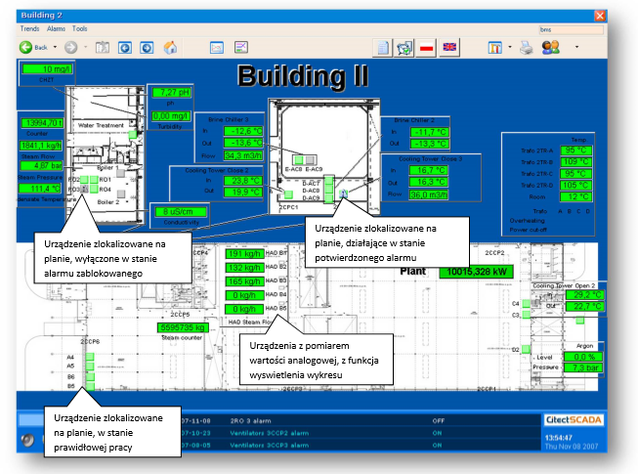
Data Visualization in BMS

Slide 5
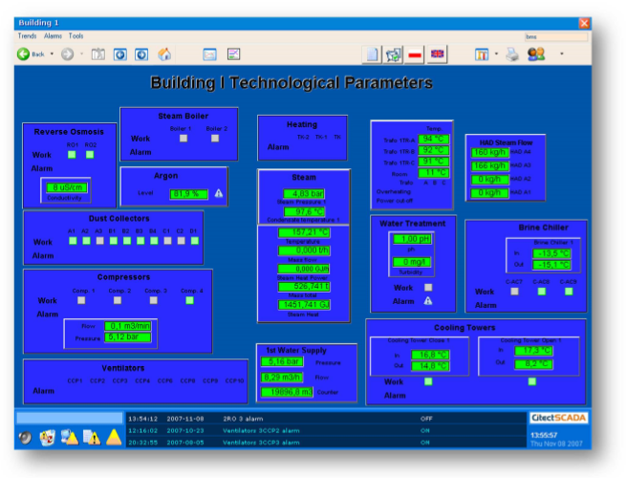
Data Visualization in BMS

Slide 6
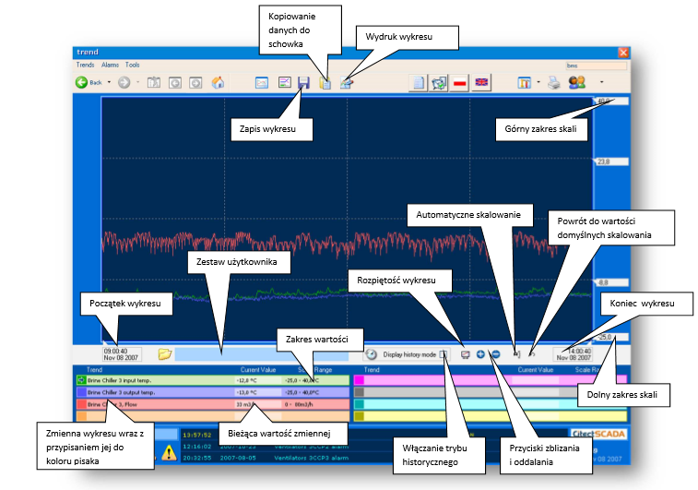
Data Visualization in BMS

Slide 7
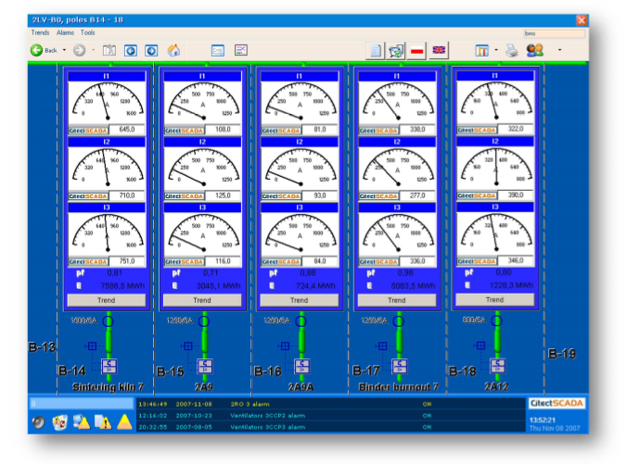
Data Visualization in BMS

Slide 8
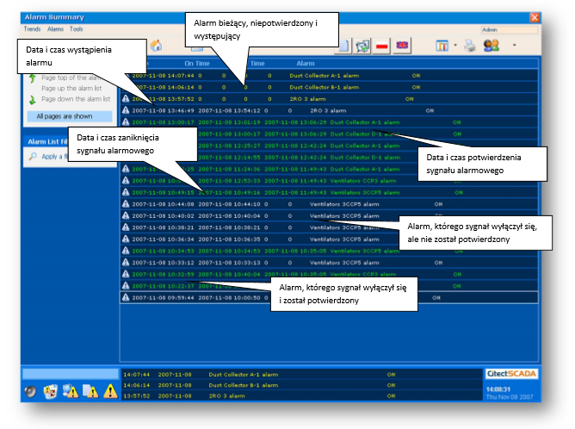
Data Visualization in BMS

Slide 9
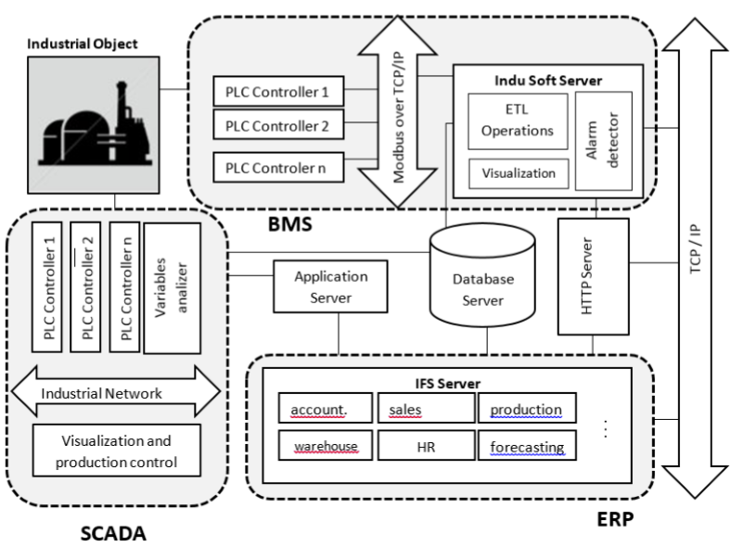
the concept of BMS as a system for integrating business information

Slide 10
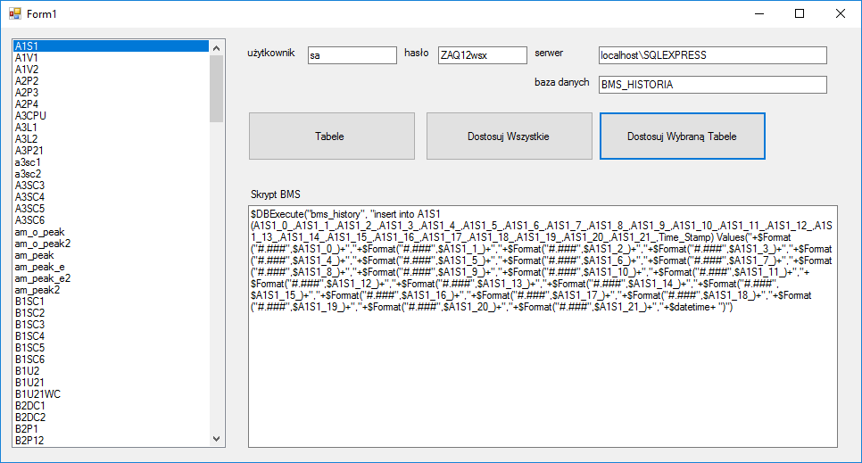
Data integrations and flexibility

Slide 11
The Mathematical Method for Resource Availability Prioritizing
MTBF (Mean Time Between Failures), which relies heavily on the quality of a component
MTTR (Mean Time To Repair), which may be dependant of a system organization and maintenance procedures.
MTBSO (Mean Time Between System/Service Outage)
MTTSR (Mean Time To System/Service Repair)
reliability of a system component
availability of service

Slide 12
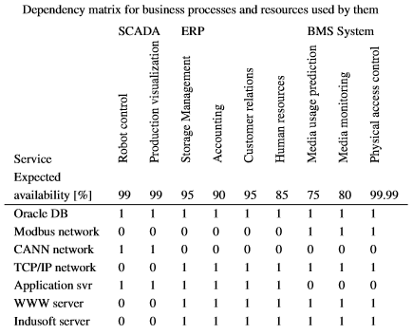
Exampe of dependency matrix
dij = 1 / n
n - the number of occurrences of the resource

