Slide 2
ii invite you

Slide 3
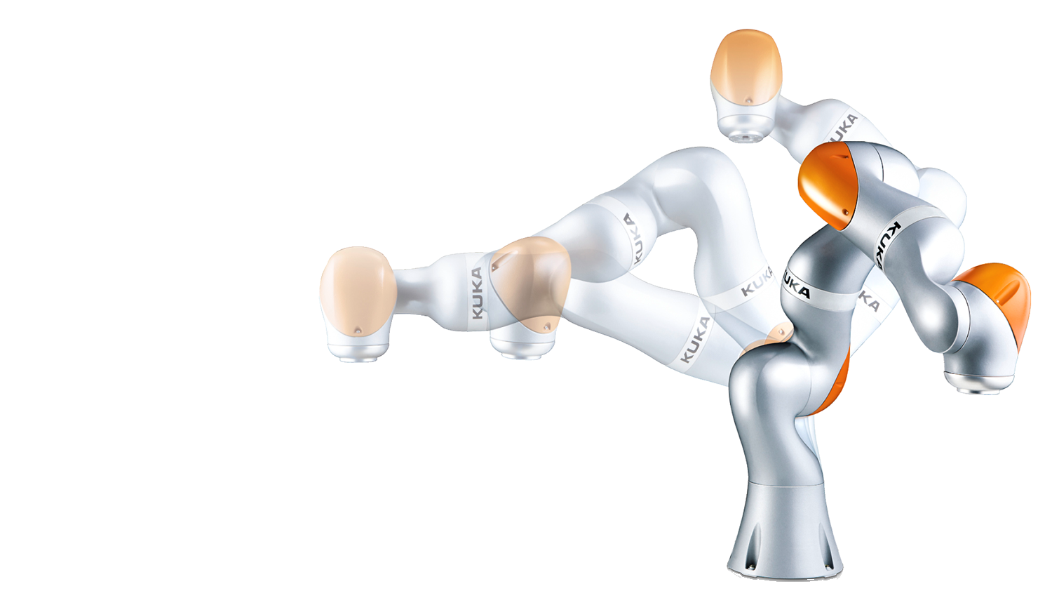
LBR iiwa
LBR stands for„Leichtbauroboter“
(German for lightweight robot),
iiwa for „intelligent industrial
work assistant“.
Notes:
Definition of the name „LBR iiwa“:
LBR is the abbreviation for the German word „Leichtbauroboter“ (lightweight robot)
Iiwa is a acronym which describes the potentials offered by the robot
Intelligent → sensitive assembly processes
Industrial → quality for industrial use
Work assistant → human-robot-collaboration

Slide 4
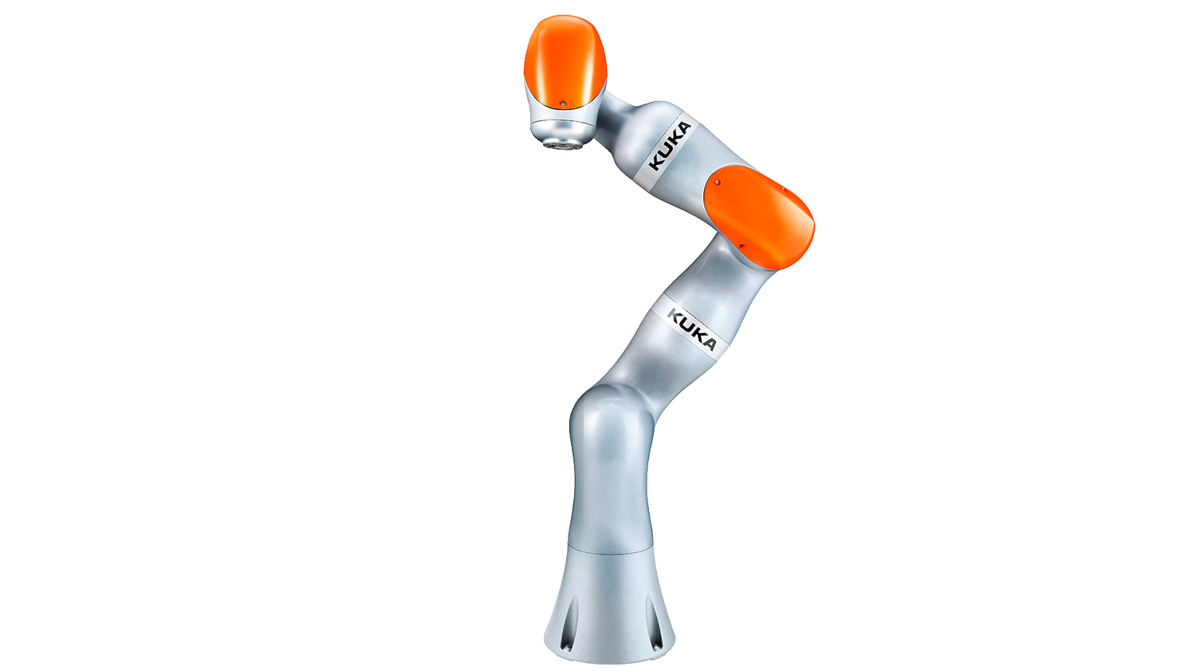
LBR iiwa – the Features
[+] Mobility
Teaching by demonstration [+]
[+] Safety
Controller for sensor-based robotics [+]
[+] Sensitivity
Bionic motions using 7 axes [+]
[+] Sensitive assembly processes
[+] Made in Germany
Compliance mode [+]
Notes:
Slide gives an overvies of the features and possibilities offered by the iiwa.
Features are explained in the following presentation.

Slide 5
The new modes – Compliance mode
The human acts, the LBR iiwa reacts
The robot‘s behaviour can be easily programmed via the software
Flexible adaption of the robot’s characteristics to the individual task
Tasks are solved by the means of compliance rather than programmed positioning
Notes:
Compliance mode offers to possibilites for the iiwa.
Active use for sensitive assembly processes
Passive use for the protection of the environment and the robot itself
Kinematic acts like a spring
Spring constant can be programmed for single joints or for the cartesian system
The TCP always returns to its origin

Slide 6
The new modes – Gravity compensation
The LBR iiwa is weightless
External gravitation is compensated via the integrated sensors and the controller
Only small application of force is necessary for moving the robot in a new pose
Is basis for features like hand guiding and teaching by demonstration
Notes:
Iiwa is weightless.
Mode is called “gravity compensation”
LBR iiwa eliminates the external forces impacting the kinematic. → Robot can be places in a user-defined position and stays there.

Slide 7
The features – Teaching by demonstration
The human teaches, the LBR iiwa understands.
Torque sensors in each axis enable programming by intuitive manual guidance
Reduced time for programming
Easy and fast capturing of positions
Programming of paths by demonstration
Combination of automation and operator-guided motion
Programmieren durch Vormachen
Teaching by Demonstration
Notes:
Iiwa offers the easiest way to teach and program a robot system.
The user demonstrates the motion by guiding the robot and afterwards the robot copies the motion
Two ways of programing the system
Teaching the coordinates of the positions and connection these points with robot motions (PTP, LIN, CIRC)
Teaching the path of the motion, which is replayed by the robot afterwards

Slide 8
The features – Bionic motions using 7 axes
LBR iiwa is designed like the human arm
It is particularly easy to be integrated in the application because of its small workspace requirements and its lightweight structure
Optimised positioning of the robot kinematic
Quantec Zentralhandmontage
Quantec hand assembly
Notes:
Iiwa implements 7 axes, one more in contrast to industrial robots
LBR is designed like the human arm
A2 is comparable to the shoulder
A4 is comperanle to the elbow
A6/A7 is comparable to the wrist
Redundancy offers the possibility to reach points on different pathes
Scenario:
LBR is fixing a component and the worker must place a weld seam. Worker must change its workspace to place another weld seam on the same object. Worker can move the kinematic due to its redundancy without moving the fixed component.

Slide 9
The features – Sensitive assembly processes
LBR iiwa offers and integrates the sensitivity for new assembly processes
Simple programming for joining processes
LBR iiwa integrates the compliance in the structure instead
Reduction of costs and cycle time in engineering, manufacturing and commissioning
Applications with integrated tactile search without vision systems
Allows imprecise feeding of components
Ungenaue Bauteilplatzierung
Imprecise feeding of components
Montage mit Nachgiebigkeit
Assembly in compliance mode
Notes:
Sensitive assembly processes are no problem for the LBR iiwa
The torque sensors are placed on the output of each joint drive system. The actual external force is measured, without the influence of the gearbox or the drive.
Using the sensors allows assembly processes with force conditions like sine waves or desired forces.
Simplifies the construction of the tools, because the systems offers and integrates the intelligence.

Slide 10
Daimler: rear axle transmission assembly

Slide 11
The features - Safety
The human needs protection, the LBR iiwa provides protection
Simplified integration into existing system concepts
Its sensors allow direct and safe interaction with the human body
New possibilities for cell concepts without fences or optical safeguards
LBR iiwa offers a configurable safety controller for HRC applications according to valid standards
Hochsensitive Kollisionserkennung
High-performance collision detection
Notes:
Safety features are integrated in the robot and the controller
Enables the robot to be placed in the environment of the human
KUKA offers a configurable safety controller, which allows the user to realise HRC applications according to valid international norms (ISO 10218-1:2011)
Critical components are monitored according to ISO 13849 (PL d, Kat 3)
Velocity
Workspace
Collision detection
Limitation of forces
Tool recognition
Switching between safety states
HRC applications must always be accessed with a risk management procedure by the system integrator!

Slide 12
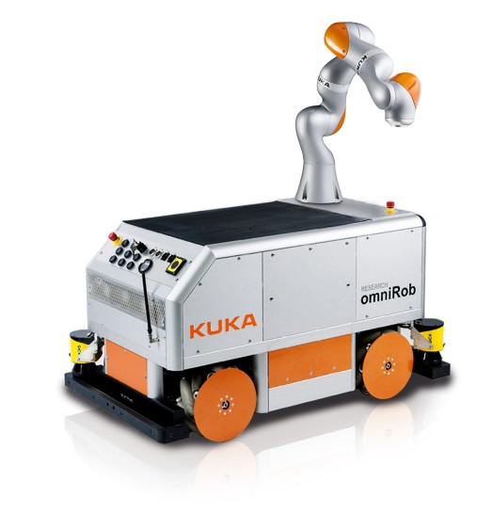
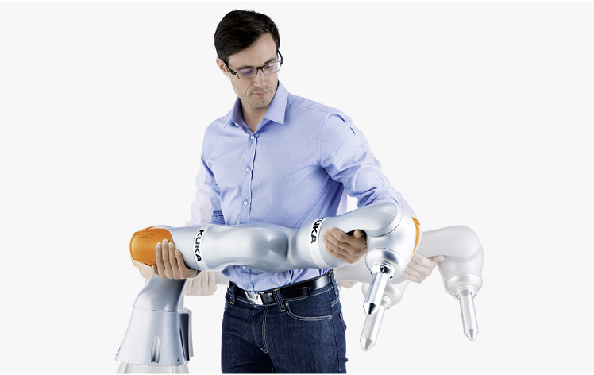
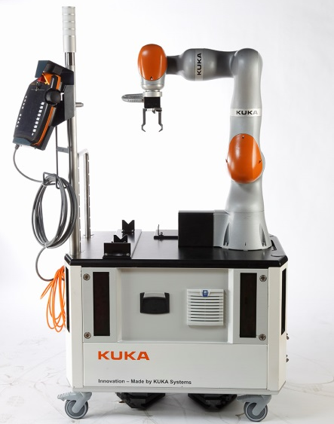
The features - Mobility
Due to the low weight the robot is easy to relocate and highly versatile
Transportable without additional equipment
Low space requirements
Optional battery operation and installation on mobile platforms for flexible applications
Notes:
Mobility is achieved by
Low weight of 23.9 kg / 29.9 kg due to the use of aluminum
Design with a smooth outline
Robot can be used on different assembly lines
Only 4 screws are necessary to fix the robot on its workplace
Realisation of mobile platform due to
Use of batteries
Fenceless operation with HRC mechanism

Slide 13
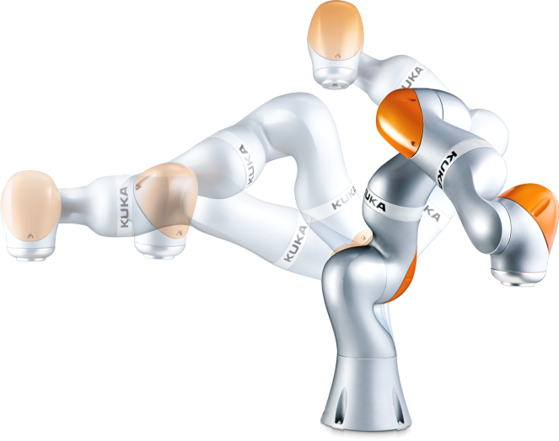
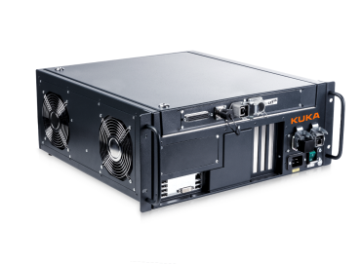
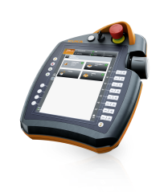
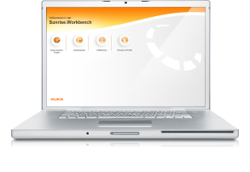
Product overview
The team for your production
KUKA Sunrise
LBR iiwa
KUKA Sunrise Cabinet
KUKA Sunrise.OS
LBR iiwa 7 R800
KUKA Sunrise.Workbench
LBR iiwa 14 R820

Slide 14
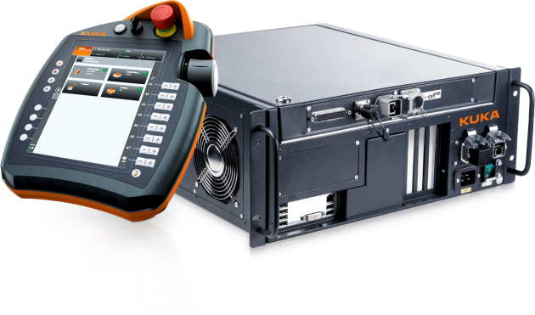
Product overview – KUKA Sunrise Cabinet
Based on KUKA „KR C4 compact“ technology
High-speed servo control
Integrated and configurable software safety controller
Compact design (19")
smartPAD with new, innovative user interface
Supports all common field bus systems
 | KUKA Sunrise Cabinet
Processor | Quadcore-Prozessor
Hard drive | HDD, SSD optional
Interfaces | USB, EtherNet, DVI-I
Protection level | IP 20
Dimensions (DxWxH) | 500 mm x 483 mm x 190 mm
Weight | 23 kg
Supply voltage | AC 110 V – 230 V

Slide 15
Product overview – KUKA Sunrise.OS
The KUKA Sunrise.OS (Operating System) is the new operating system for the LBR iiwa
KUKA Sunrise.OS – the technological platform for innovative robotics:
Multi-kinematics
Human-robot collaboration
Integration of sensors
Object-oriented programming
Integration von Sensorik
Integration of sensors

Slide 16
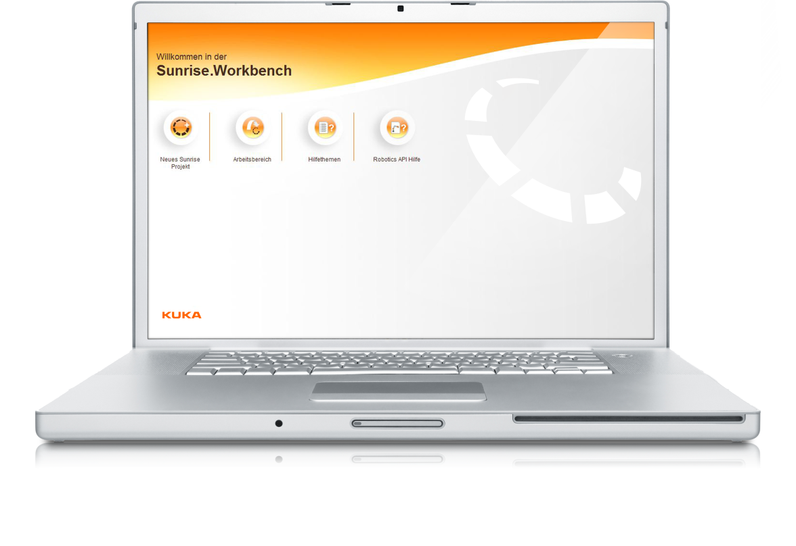
Product overview – KUKA Sunrise.Workbench
New engineering suite
Easy-to-use user interface
Editor with powerful and user-friendly functions
Object-oriented programming
Simple project management
Fast start-up procedure
Powerful diagnostics
Integrated user manual

Slide 17
Product overview
The team for your production
KUKA Sunrise
LBR iiwa
KUKA Sunrise Cabinet
KUKA Sunrise.OS
LBR iiwa 7 R800
KUKA Sunrise.Workbench
LBR iiwa 14 R820

Slide 18
Product overview – LBR iiwa, 7 kg and 14 kg
Lightweight construction using aluminum design
Torque sensors in fail safe technology
Drive-electronics placed inside the mechanics
Automated mastering
LBR iiwa | LBR iiwa 7 R800 | LBR iiwa 14 R820
Rated payload | 7 kg | 14 kg
Number of axes | 7 | 7
Mounting flange A7 | DIN ISO 9409-1-A50 | DIN ISO 9409-1-A50
Mounting position | User-defined | User-defined
Protection level | IP 54 | IP 54
Pose repeatability | ±0,1 mm | ±0,1 mm
Torque accuracy (per axis of maximum torque) | ±2 % | ±2 %
Weight | 23,9 kg | 29,9kg

Slide 19
Options – Energy supply
The energy supply for external components is placed inside the kinematic structure
Two energy supply systems are available
Pneumatic
2 x air (Diameter 4,0 mm)
2 x electric (1,0 mm²)
1 x ethernet-compliant cabling
Electric
3 x twisted-pair wires (AWG28)
4 x electric (1,0 mm²)
1 x ethernet-compliant cabling

Slide 20
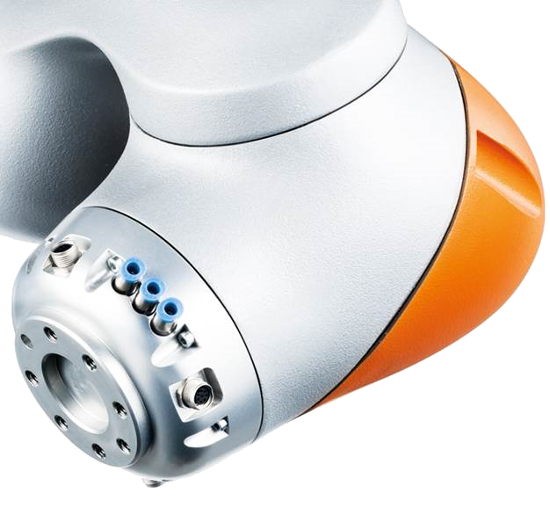
Options – media flange
Media flange is available in different options with different interfaces
Available media interfaces
Pneumatic, without valve
Pneumatic, with valve
Energy supply 24 V
Analogue electrical wires
Digital inputs/outputs
Ethernet-compliant cabling
Available intelligent interfaces
Dead-man switch
Application switch
Tool recognition

Slide 21
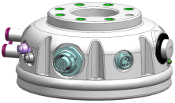
Options – media flange
Media-Flange
Standard
IO
Touch
Energy supply pneumatic
Media-Flange pneumatic
Media-Flange IO pneumatic
Media-Flange Touch pneumatic
-2x Air (2x 4 mm air connection not switched)
-1x Power supply (3 A 24 V, M8 connector)
- Interface for fieldbus and low level signals (EtherCAT junction, 8 Inputs, 4 Outputs each 0,5 A, M8 connector)
-2x Air (2x 4 mm air connection not switched)
-1x Power supply (3 A 24 V, M12 connector)
-Interface for fieldbus and low level signals (EtherCAT junction, 5 Inputs, 4 Outputs each 0,5 A, M8 and M12 connectors)
-Enabling switch, App-button (programmable), three-colored LED status indicator
-2x Air (2x 4 mm air connection not switched)
-1x Power supply (5 A max. 30 V, M8 connector)
- Interface for fieldbus and low level signals (4x AWG 26 shielded, M8 connector)
Energy supply electric
Media-Flange electric
Media-Flange IO electric
Media-Flange Touch electric
-2x Power supply (each 5 A max. 60 V, M8 connector)
- Interface for fieldbus and low level signals (4x AWG 26 shielded, 3x2 AWG 28 shielded in pairs, M8 connector)
-2x Power supply (1x 3A 24V, 1x 4A max. 60V, M8 connector)
- Interface for fieldbus and low level signals (Ethercat junction, 8 Inputs, 4 Outputs each 0,5 A, 4x AWG 26 shielded, 3x2 AWG 28 shielded in pairs, M8 connector)
-2x Power supply (1x 3A 24V, 1x 4A max. 60V, M8 connector)
-Interface for fieldbus and low level signals (EtherCAT junction, 5 Inputs, 4 Outputs each 0,5 A, 3x2 AWG 28 shielded in pairs, M8 and M12 connectors)
-Enabling switch, App-button (programmable), three-colored LED status indicator

Slide 22
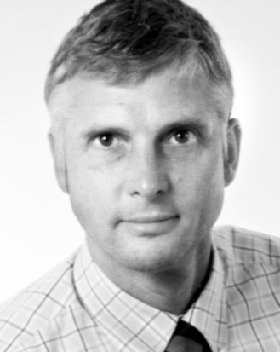
KUKA LBR iiwa contacts
Michael Gerung
Industrial Business Development
Sales LBR iiwa
Phone: +49 821 4533-3029
Mobile: +49 172 8218120
E-Mail: MichaelGerung@kuka-roboter.de
Michael Reimer
Industrial Business Development
Sales LBR iiwa
Phone: +49 821 4533-3576
Mobile: +49 174 9194341
E-Mail: MichaelReimer@kuka-roboter.de
Manfred Micheler
Industrial Business Development
Sales LBR iiwa
Phone: +49 821 4533-4645
Mobile: +49 172 8217660
E-Mail: ManfredMicheler@kuka-roboter.de
Enter the new era of sensitve robotics
lbr-iiwa.com youtube.com/KukaRobotGroup

